Slide 1
The impact of generative AI on social media: an experimental study
Week of April 13th
Elias Hord

Slide 2
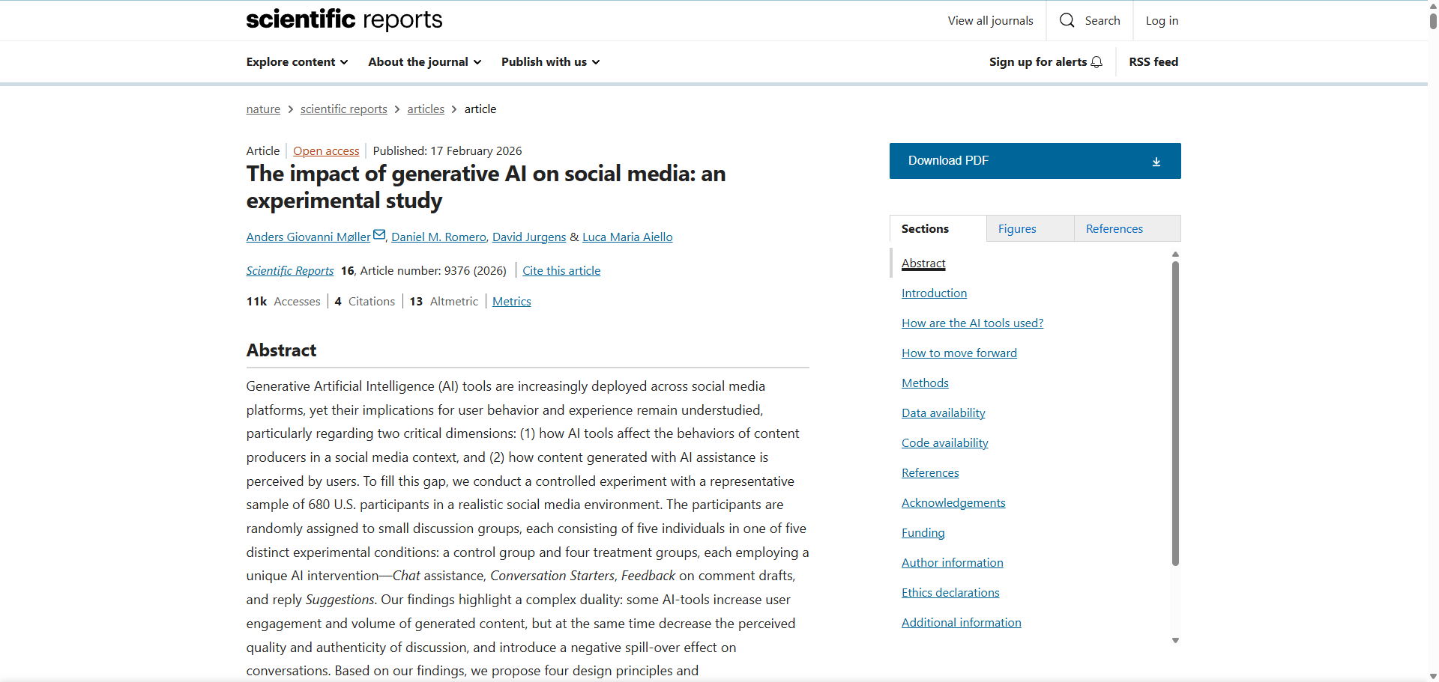
General Information
Article Publication: February 17th, 2026
https://www.nature.com/articles/s41598-026-40110-8

Slide 3
Main Findings and Arguments
The study uses a controlled experiment with 680 U.S. participants placed in simulated social media discussions with different AI tools (e.g., chat assistance, reply suggestions).
Key finding: a trade-off (duality)
AI tools increase engagement and content volume (people post more and interact more).
However, they reduce perceived quality and authenticity of conversations.
AI-generated or AI-assisted content can create “negative spillover effects”, meaning:
Conversations become less meaningful overall
Even non-AI users are affected by reduced discussion quality
The authors propose four design recommendations:
Transparency (clearly disclose AI-generated content)
Personalization (adapt tools to users)
Context awareness (match AI responses to situation/topic)
Usability (simple, intuitive interfaces)
👉 Overall argument: Generative AI boosts participation but risks degrading trust and authenticity, requiring careful design and governance.

Slide 4
Broader Implications for Society
Trust and authenticity crisis As AI content becomes widespread, users may struggle to distinguish real human interaction from AI-assisted communication, weakening trust in online platforms.
Information quality vs. quantity dilemma Society may face an environment where there is more content than ever, but lower perceived value, potentially contributing to misinformation, superficial discourse, or “content fatigue.”
Behavioral influence of AI AI doesn’t just assist—it shapes how people communicate, potentially standardizing opinions, tone, and expression.
Policy and ethical considerations The study reinforces the need for:
Regulation around AI disclosure
Ethical design standards
Platform accountability
Human-AI interaction norms Long-term, this could redefine what counts as “authentic communication” in digital spaces.

Slide 5
Relevance or Potential Influence on the Construction Industry
1. Project Communication Risks
AI tools used in emails, RFIs, and reports may:
Increase speed and volume of communication
But reduce clarity, nuance, and perceived trustworthiness
This could impact coordination between contractors, engineers, and clients.
2. Collaboration Platforms (e.g., BIM + AI)
AI-assisted collaboration tools could:
Improve participation in planning discussions
But risk generic or less thoughtful input, lowering decision quality
3. Documentation Quality
AI-generated reports, safety logs, or progress updates:
May become more frequent
But could be seen as less credible if overused or not transparent
4. Client Trust and Transparency
Just like social media users value authenticity, construction clients may demand:
Clear disclosure of AI-generated analyses or reports
Human verification of critical decisions
5. Design and Workflow Recommendations
Transparency → disclose AI use in project deliverables
Context-awareness → tailor AI tools to project-specific conditions
User-focused design → ensure AI assists rather than replaces expert judgment

